Slide 1
Predictive Modeling for Disease Diagnosis

Slide 2
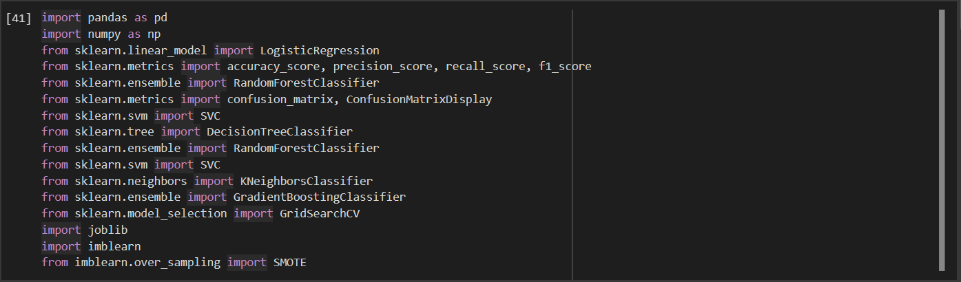
Importing Liberaries

Slide 3
Reading the data

Slide 4
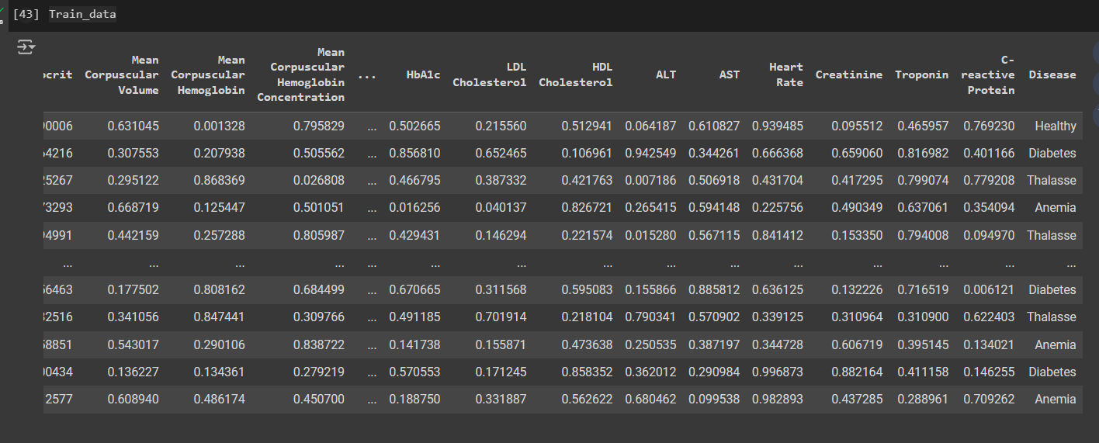
Showing Samples from the data

Slide 5
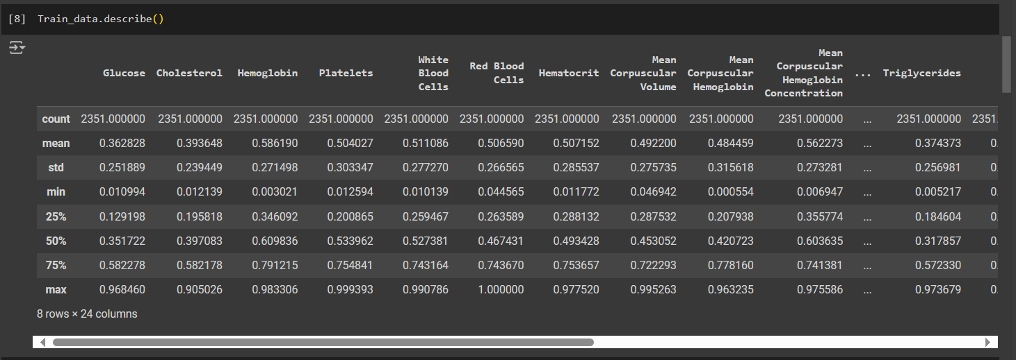
Showing data decireption

Slide 6
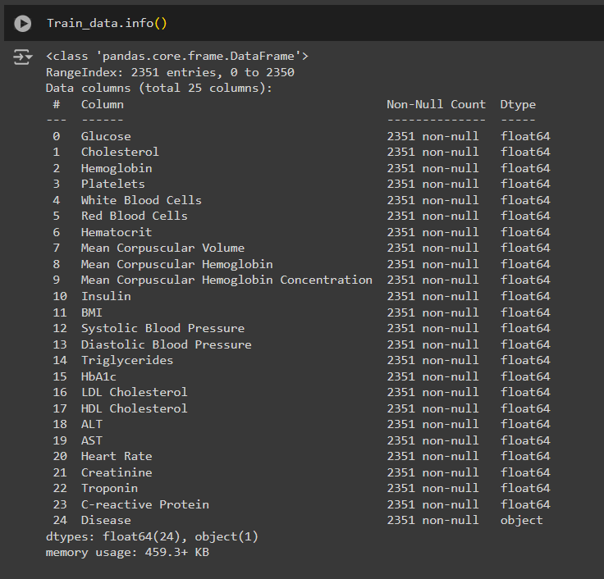
Showing data Inforamtion

Slide 7
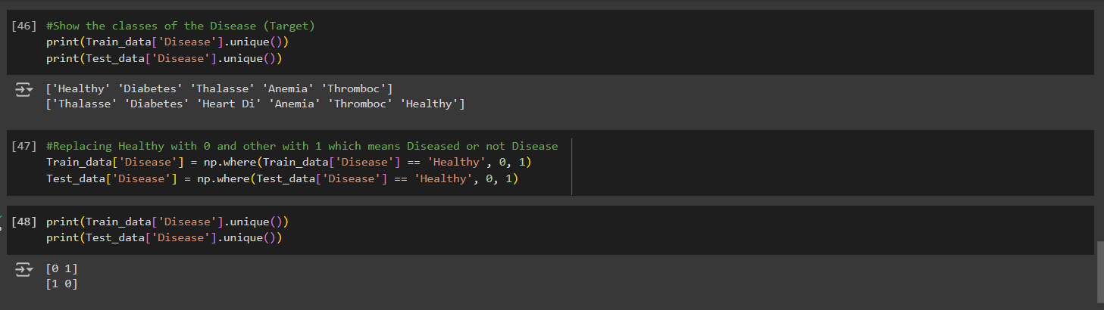
Decoding the Disease column to 0 & 1

Slide 8
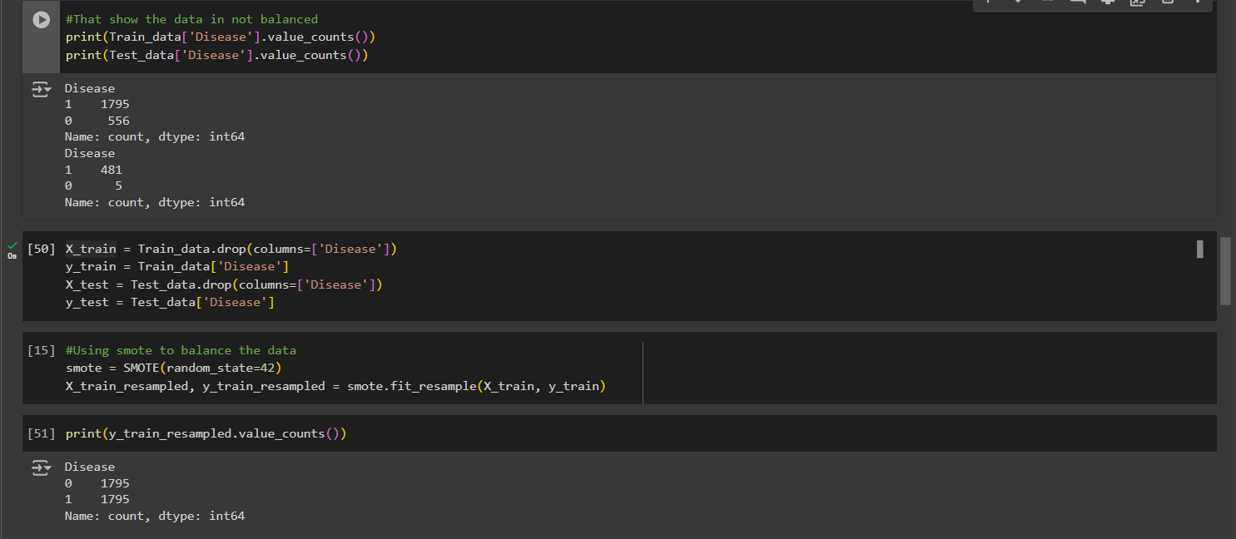
Fixing the Imbalance problem

Slide 9
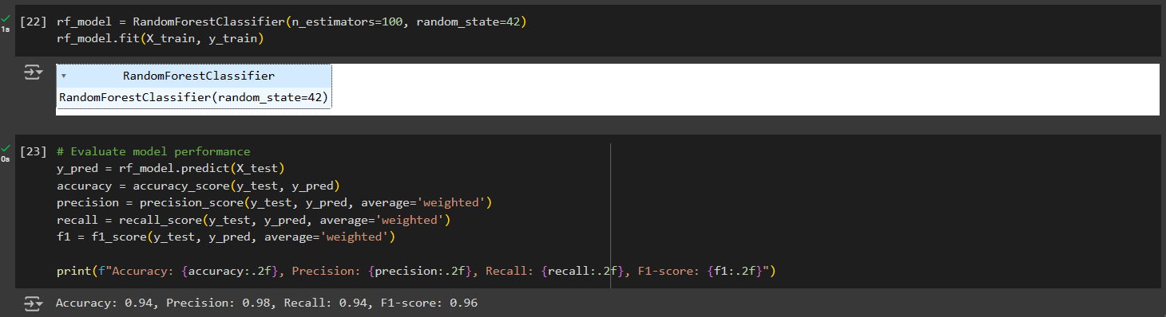
Building Radnom Forest model

Slide 10
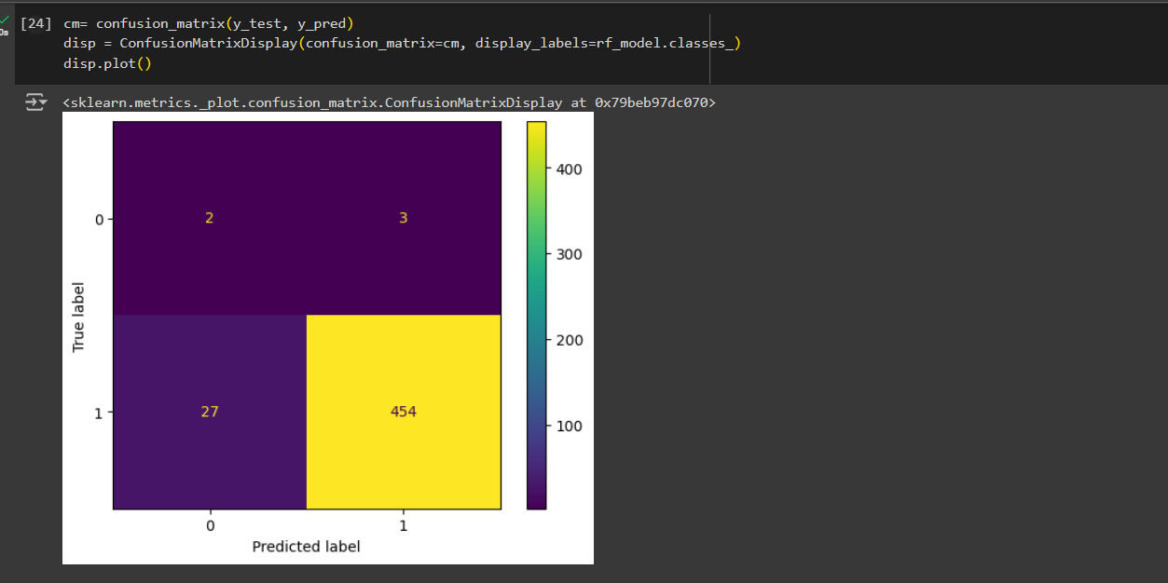
Showing the confusion matrix

Slide 11
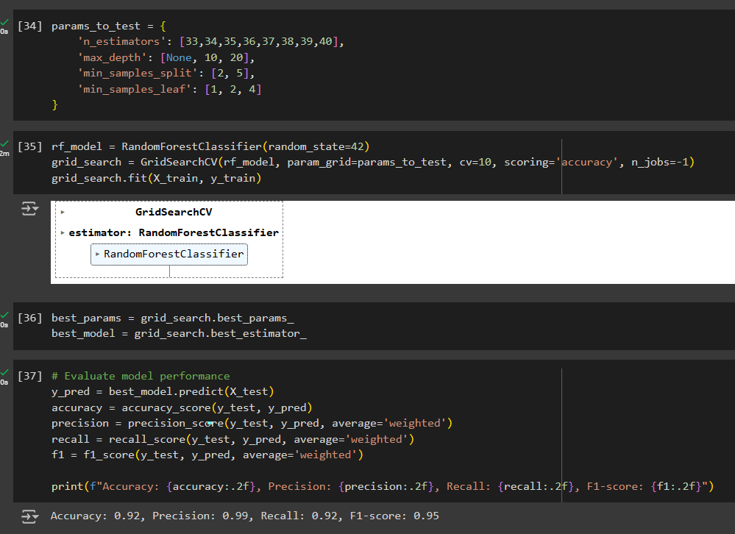
Applying grid search for the model

Slide 12
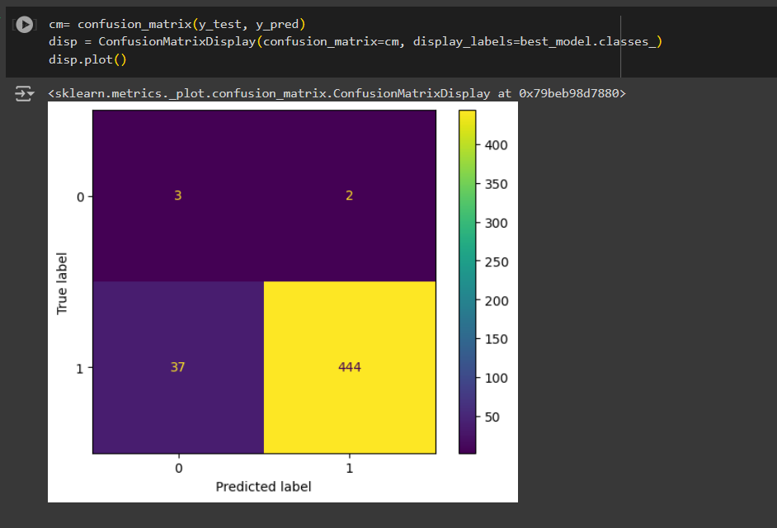
Showing the confusion matrix

Slide 13
Showing the confusion matrix
Model 1
Model 2

